Slide 1

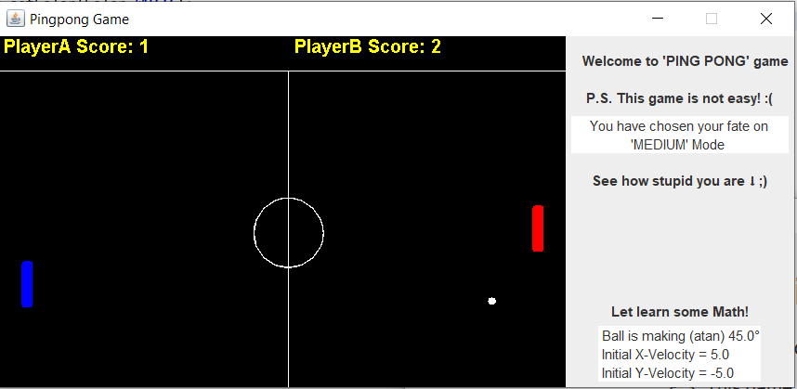
FRUSTRATING PINGPONG GAME
Nattapon Chanpurk 6422782779
Section3 Group3 ExamRoom5

Slide 2
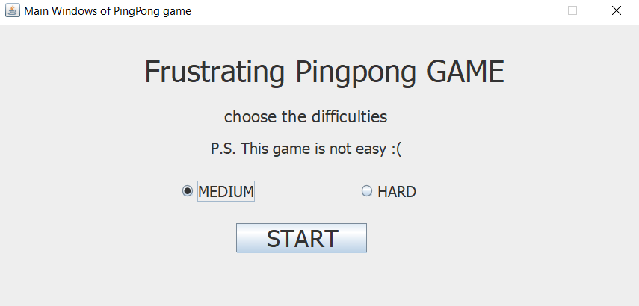

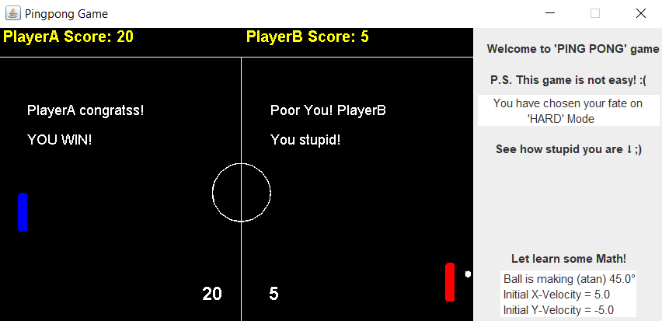

MAIN GOAL
Choose the desired difficulty and click START!
Move the paddle by
PlayerA: W/S key
PlayerB: up/down key
One of the player gets 20 points to win the game!
(All components stop)
Blaming text shows up! With the finalized score

Slide 3
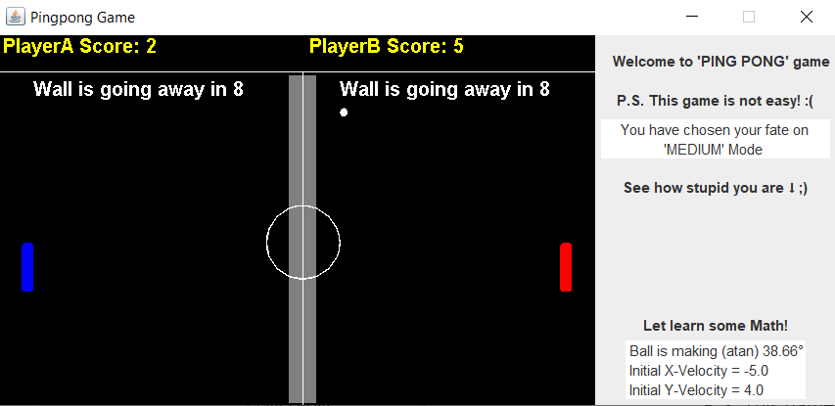

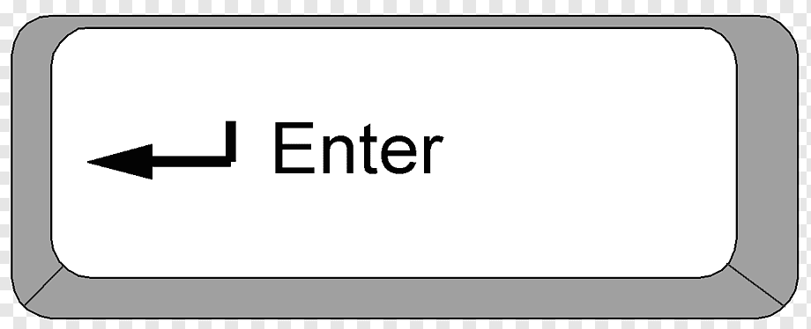

SPECIAL OPTION!!
BUILD the center wall to make your opponent frustrated!
The ball is bouncing only in their side.
Build the wall by
PlayerA: Q key
PlayerB: ENTER key
The wall will disappear in 10 seconds
The text will show the countdown time left

Slide 4
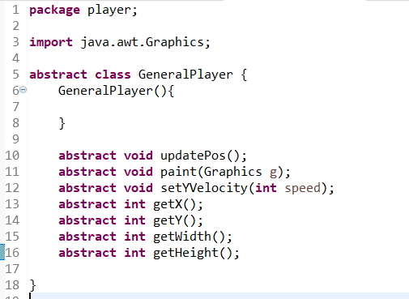
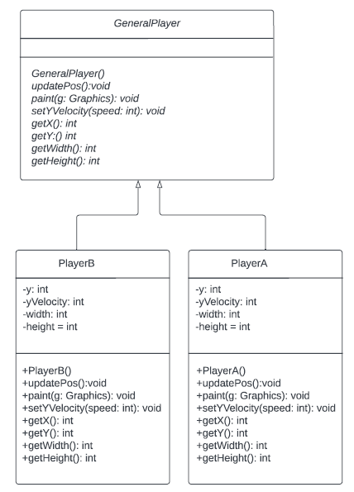
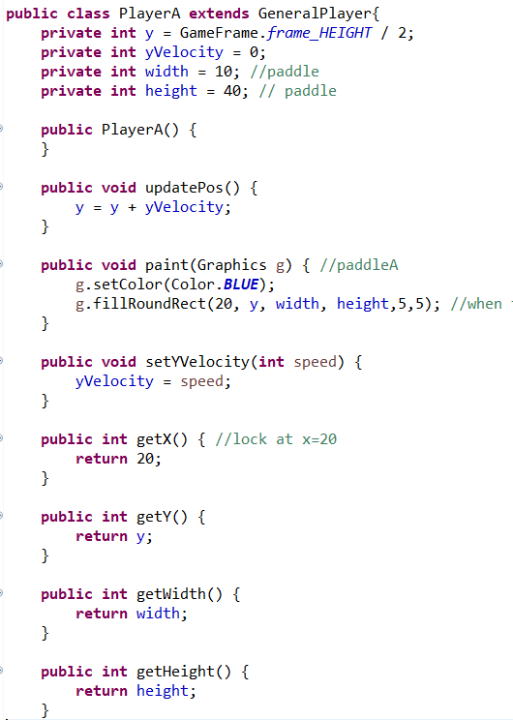
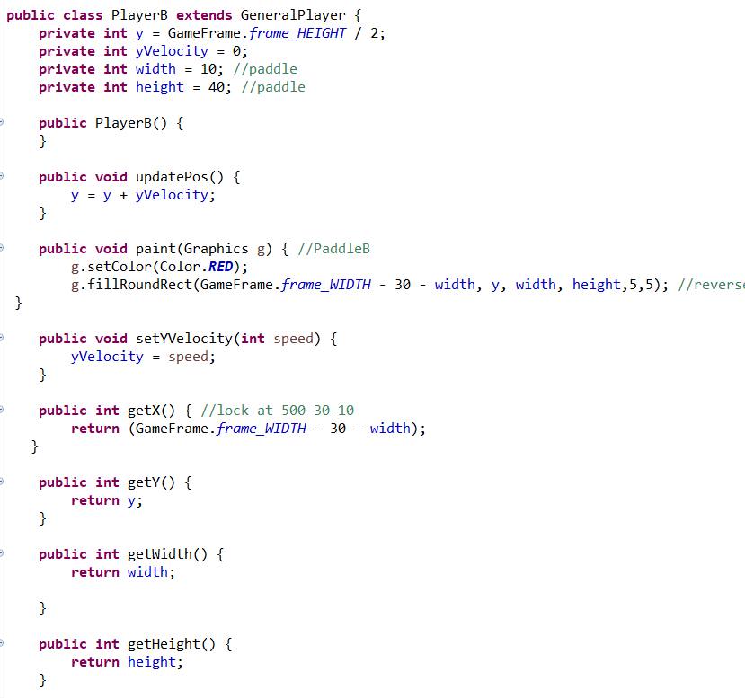

UML checklist 1
1
Extends the abstract class

Slide 5
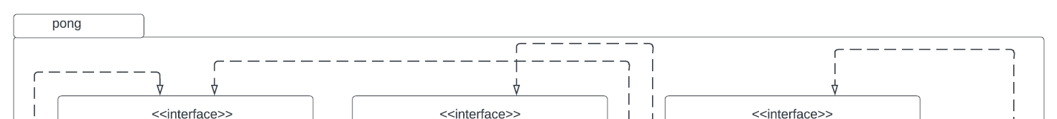
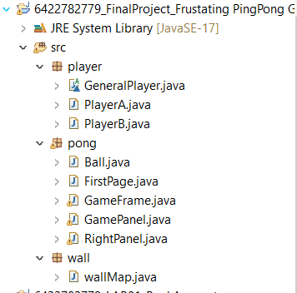
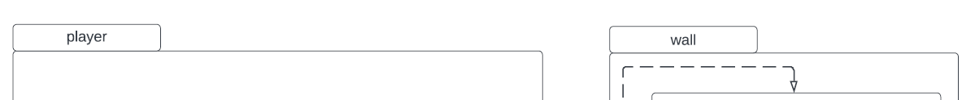
UML checklist 3
3 packages
3

Slide 6
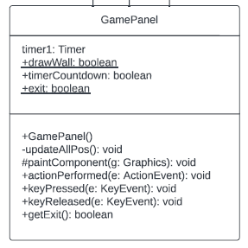
UML checklist 4
Visibility
private
You can see visibility (Encapsulation) throughout the code
This is just an example (Not done yet)
protected
4
public
4
Checking (super, this) soon!

Slide 7
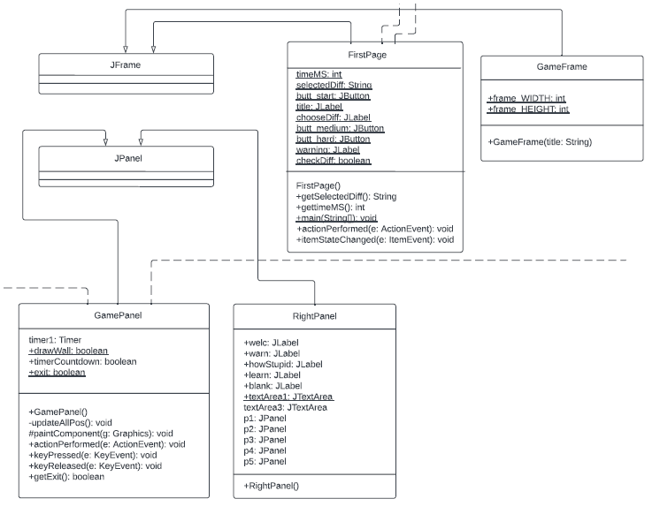
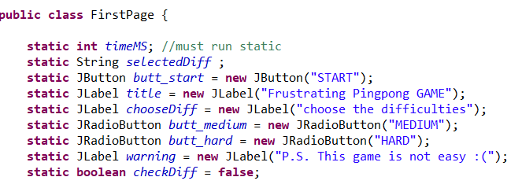
UML checklist 5/6
Containers and Components
2 JFrame and 2JPanel with
5 sub Jpanel inside RightPanel.java
5
4 distinct components: JTextArea, JLabel, JButton, JRadioButton
6

Slide 8
EXPLAIN THE GAME! FURTHER CHECKLIST (2,7-13)

Slide 9

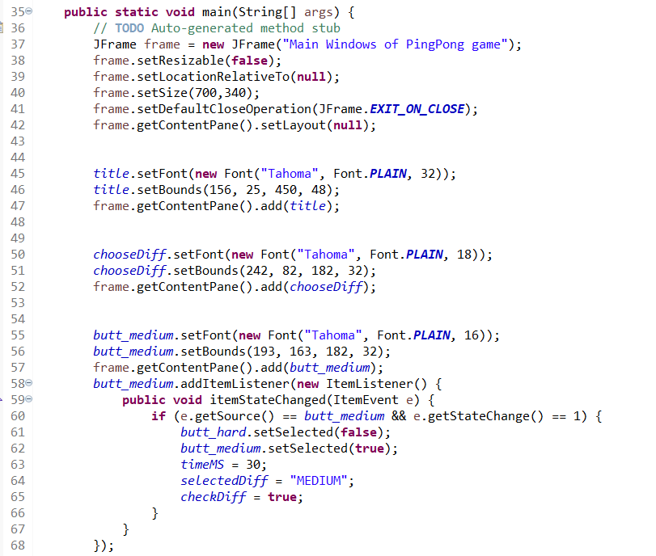
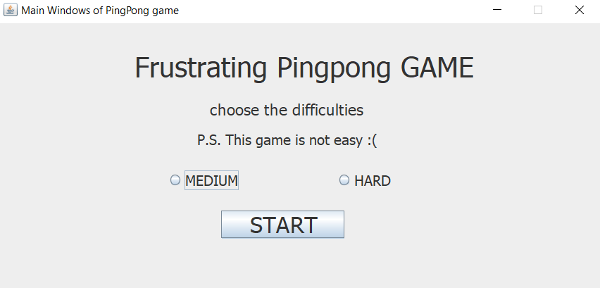
FirstPage.java
1. Run the game
Main is in FirstPage.java
JFrame of Main Windows
11
10
Note more fire events are coming!
Now Event : ItemEvent
Set Timer speed (speed of ball)
Difficulty button selected

Slide 10
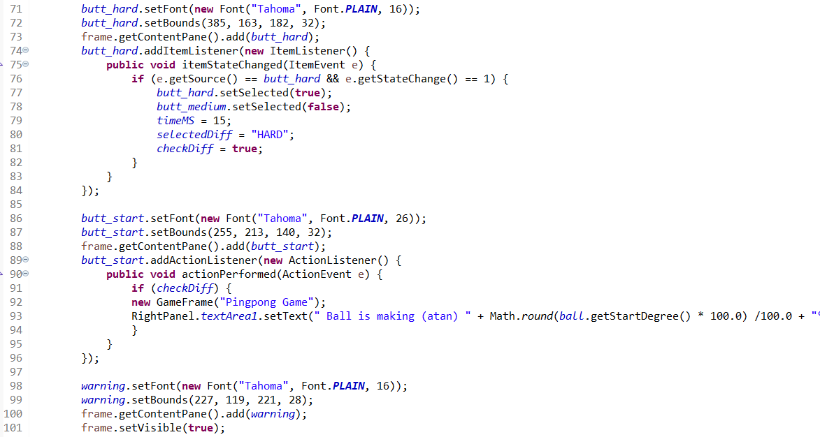
FirstPage.java
1. Run the game
Main is in FirstPage.java
11
10
Set Timer speed (speed of ball)
Difficulty button selected
If JRadioButton selected
Open new JFrame
GameFrame.java
11
2 typed events counted
12
Note 2 fire event in this class: (Still more in another class)
Now Event: ActionEvent / ItemEvent
Math in overridden

Slide 11

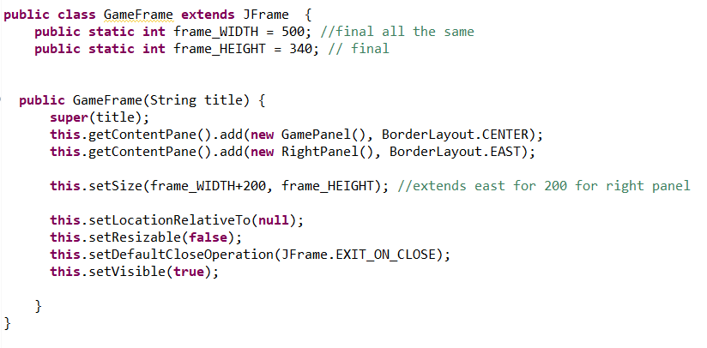
GameFrame.java
7
4
super, this
GamePanel.java RightPanel.java
Consists of 2 classes: GamePanel.java → Main PingPong game
RightPanel.java → Scoreboard, settings panel

Slide 12
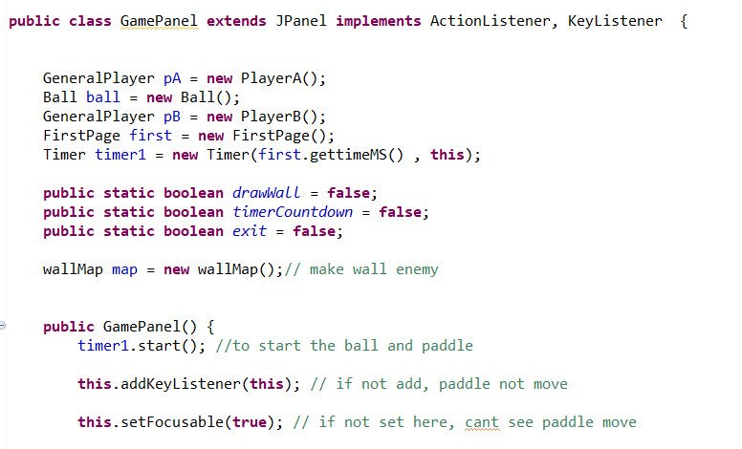
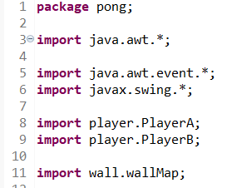
GamePanel.java
2
Implicit Casting
13
10
1 Listener

Slide 13
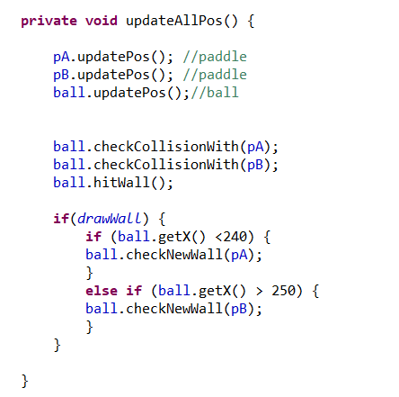
GamePanel.java
All updated components are using timer1
timer1 = control all moving graphics
Including, Paddle A, B, ball, and when the ball hit the L/R or new center wall
From void keyPressed (KeyEvent e)
The ball is in playerA side, and have to bounce to new center wall
The ball is in playerB side, and have to bounce to new center wall

Slide 14
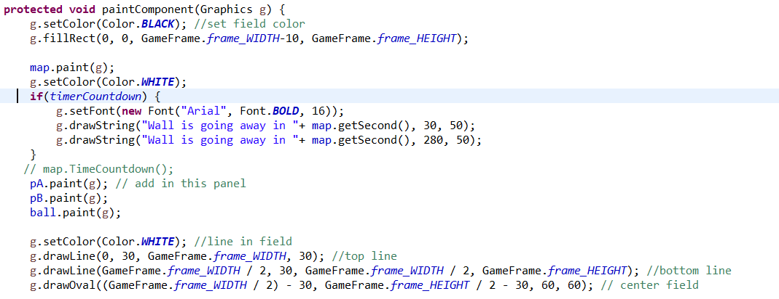
GamePanel.java
paintComponent of object inside
9
8
Put here!, because need to be ready to switch gray wall with black field at anytime
Still more color in the code
g.fillRect
g.drawLine
g.drawOval
And more
9
8
8

Slide 15
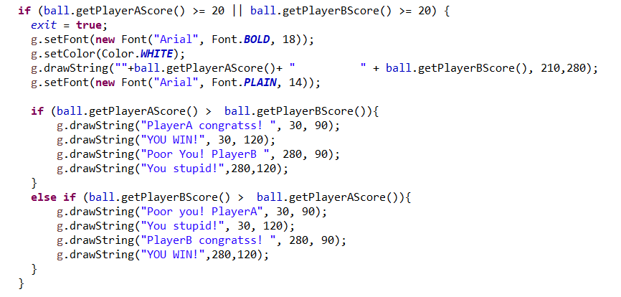
GamePanel.java
Blaming Text in paintComponent
Game ends when one side’s score >= 20
Send exit to timer1 in ActionPerformed
Blame! when the game ended

Slide 16
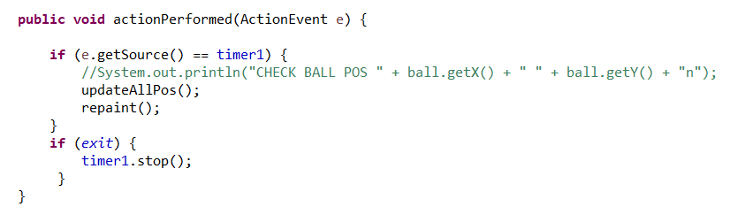
GamePanel.java
Start/ stop the timer1 of the game
The timer1 already started in GamePanel()
Updated the defined void method // Don’t forget to repaint()
From above condition in paintComponent(Graphics g)

Slide 17
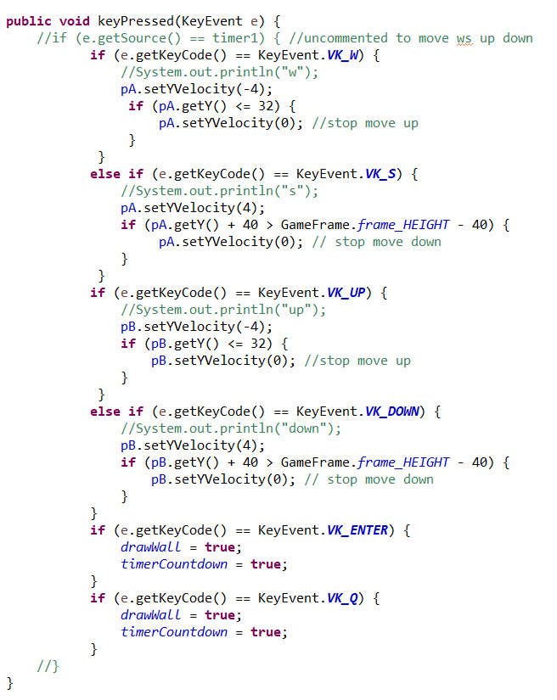
GamePanel.java
Now: ActionEvent, ItemEvent, KeyEvent
11
A lot of fire events
e.getKeyCode() == KeyEvent
10
W/S keys move Paddle A
Up/down keys move Paddle B
PLAYER.setYVelocity(int speed) when the key pressed
Getting more frustration!
Press Q/ENTER key to build a new center wall
And start new timer2 to countdown for 10 seconds
drawWall sends to condition in void updateAllPos() → check movement
timerCountdown sends to condition in void paintComponent(Graphics g)
&& wallMap in package <<wall>> → paint new wall

Slide 18
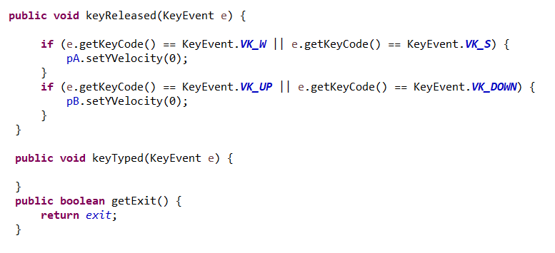
GamePanel.java
Stop the paddle movement when releasing the key W/S/up/down
10
Send to condition in void paintComponent(Graphics g)

Slide 19
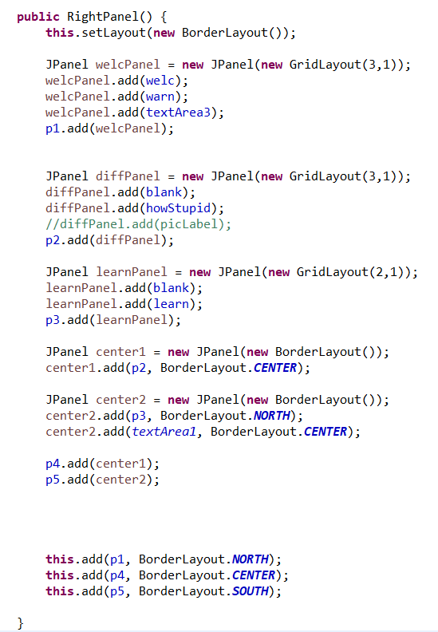
RightPanel.java
A lot of JPanel in this class
7
GridLayout() and BorderLayout()

Slide 20
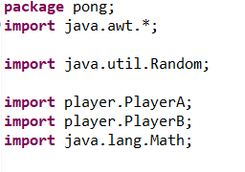
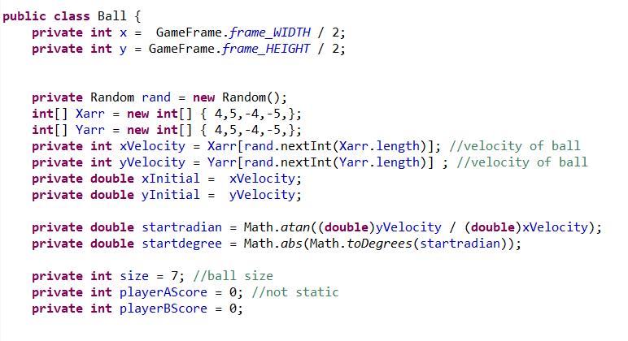
Ball.java
Mostly Implicit Casting from earlier ex.
private Random rand = new Random();
Parse int to (double)
Explicit Casting
Ex. (double)yVelocity, (double)xVelocity
2
We have included everything in the list! But let’s continue!

Slide 21
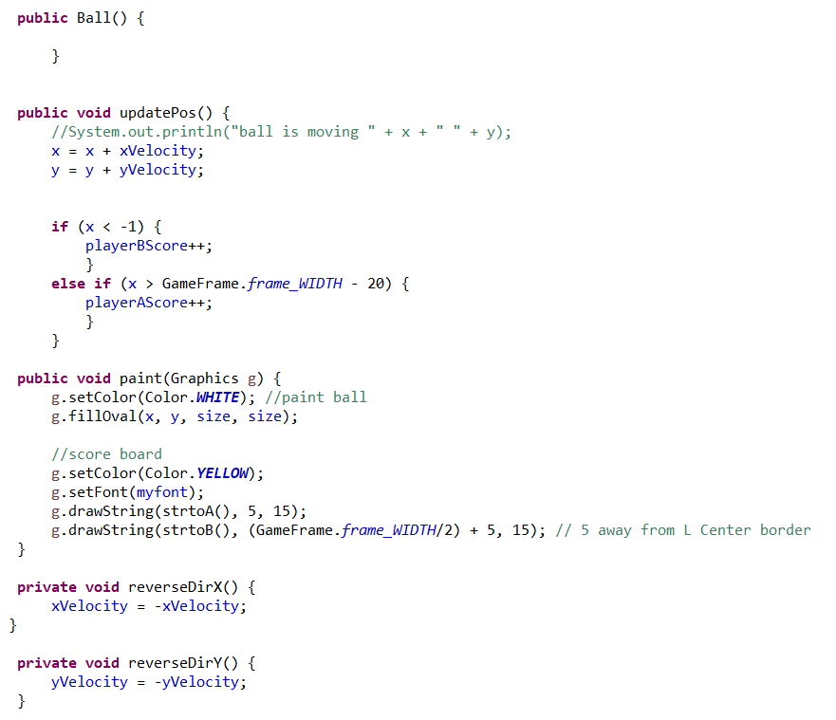
Ball.java
Calculating Score
If the ball hit coordinate x < -1: (playerBScore +1);
If the ball hit coordinate x > 500-20: (playerAScore +1);
9
Paint white ball, setColor = white
9
Paint score board, setColor = yellow
void checkNewWall(both player), void hitWall()

Slide 22
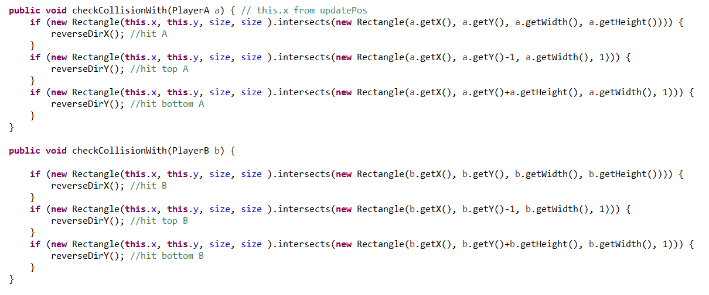
Ball.java
reverseDirY()
reverseDirX()
reverseDirY()
reverseDirX()
HIT
Bouncing:
Top/ Bottom of paddle: reverseDirX(); (BLUE REFLECT)
Left Right Side of paddle: reverseDirY(); (GREEN REFLECT)
reverseDirY()

Slide 23
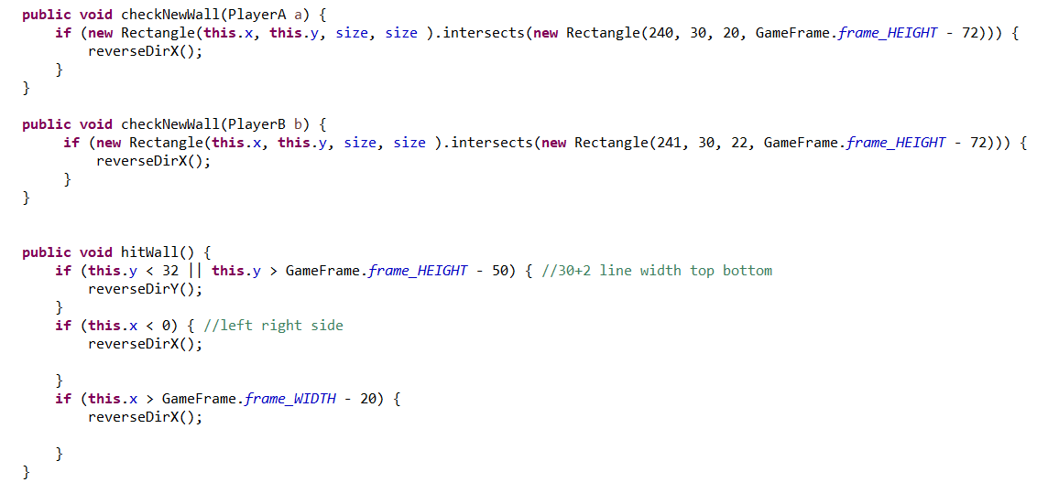
Ball.java
Bouncing the new center wall
After receiving key_Q, key_ENTER
Bouncing the original L/R wall
reverseDirX() when x < 0 and x > 500-20
reverseDirY() when y < 32 and y> 340-50

Slide 24
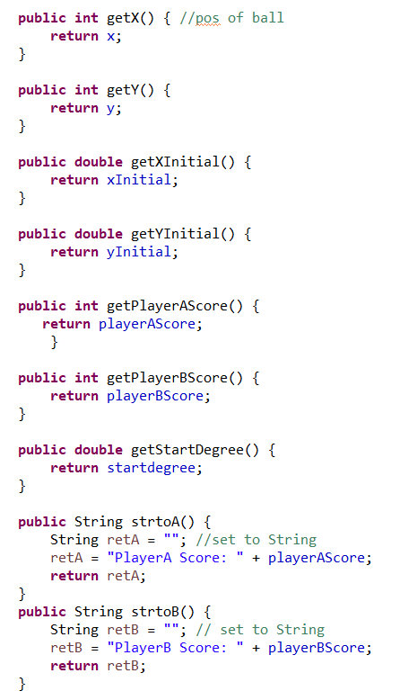
Ball.java
GamePanel.java
GamePanel.java
FirstPage.java
FirstPage.java
Normal return method
GamePanel.java
GamePanel.java
FirstPage.java
To paint(Graphics g)
To paint(Graphics g)

Slide 25
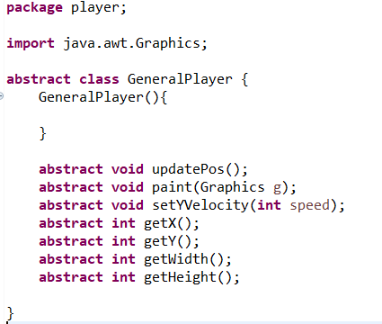
GeneralPlayer.java
Abstract Class

Slide 26
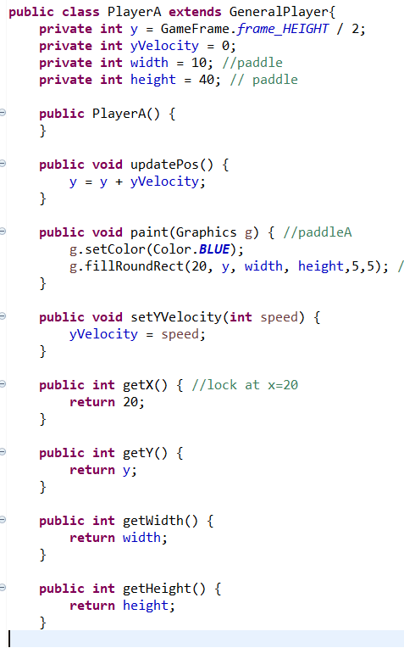
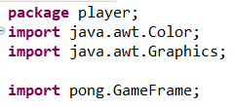
PlayerA.java
GamePanel.java
8
9
GamePanel.java
Ball.java
Ball.java
Ball.java
Overridden abstract method
Ball.java

Slide 27
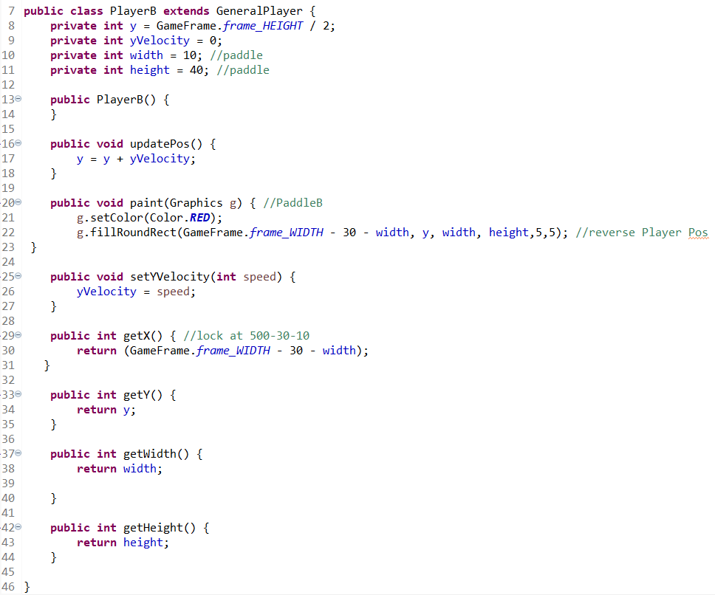

PlayerB.java
8
9
GamePanel.java
Ball.java
Ball.java
Ball.java
Overridden abstract method
Ball.java

Slide 28
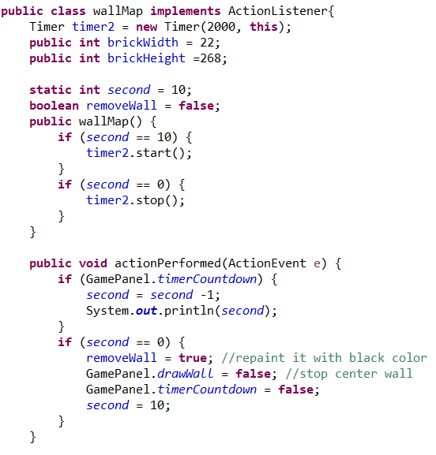
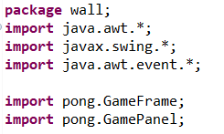
wallMap.java
Set delay for 2 seconds
(BUG)
Show seconds left in Console
The center wall and the countdown string disappeared
Don’t forget to set timer back to 10 seconds

Slide 29
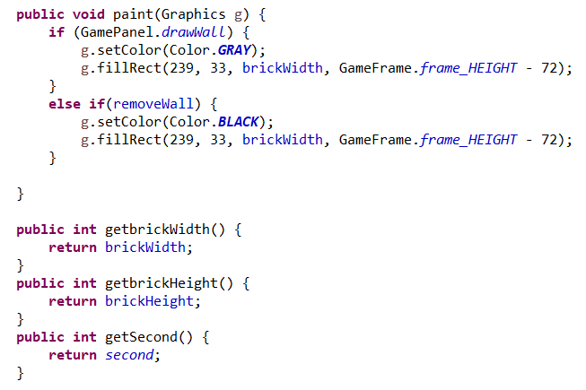
wallMap.java
8
9
8
9
Paint another layer to the grey wall, turning it to black
paint(Graphics g)
paint(Graphics g)
GamePanel.java

Slide 30
THANK YOU! ANY QUESTION?

